Slide 1
IMAGE STORY TELLER
MUHAMED SADHIQ PV
MES20MCA032
PRODUCT OWNER: MR MUHAMMAD JABIR C

Slide 2
TABLE OF CONTENTS
Introduction
Objectives
Modules
Data Flow Diagram
Table Design
Developing Environment
Product Backlog
User Stories
Project Plan
Sprint Plans
Sprint Actual

Slide 3
INTRODUCTION
The aim of the project is to develop a software which will convert a text story into its corresponding image story. This software can represent a simple or even a big story with images corresponding to each sentence in the story. Each sentence of the given story is analyzed for its meaning and matching images are extracted from the web using Google Search Engine. The sentences are replaced by images which can convey the meaning of the text data, so that, the user obtains an image story line as an output for the text story line given as input. For finding which all words in each sentence make it meaningful, we make use of the NLTK module available in Python. At first, each word in the given story is tokenized using the tokenizer available in Python. The image story is designed in such a way that the images are represented in a gallery format. There is button which can be clicked to get the double corresponding to each sentence in the story. The sentence for each image, is also displayed below it, so that it can be understood in a better way

Slide 4
OBJECTIVE
Currently to understand the inner meaning of an image people must either search or go to some experts for help. It is time consuming and sometimes images are not interpreted correctly. The project develop a software which will convert a text story into its corresponding image story. Each sentence of the given story is analyzed for its meaning and matching images are extracted from the web using Google Search Engine. The sentences are replaced by images which can convey the meaning of the text data, so that, the user obtains IMAGE STORY TELLER as an output for the text story line given as input. Thus users can understand the meaning of the image in a better way.

Slide 5
USER MODULES
MODULES
ADMIN
Login
Add Data Set(images)
View Users
View Feedbacks
USER
Registration
Login
Story Teller
Feedback

Slide 6
FUNCTIONAL MODULES
Text to Image Conversion
Text to Image Conversion is the next module.
This module involves:
Story to sentences
sentence comparison
tokenization
remove stop words from the string
stemming
create a vector containing keywords of both strings
cosine similarity
Extract image from dataset with maximum similarity

Slide 7
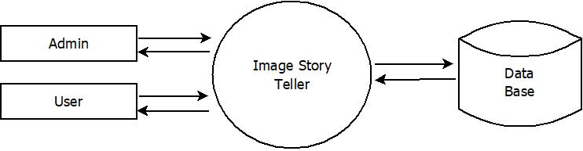
DATA FLOW DIAGRAM
LEVEL 0

Slide 8
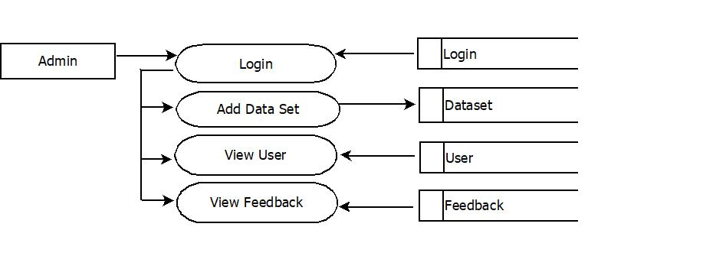
LEVEL 1.1

Slide 9
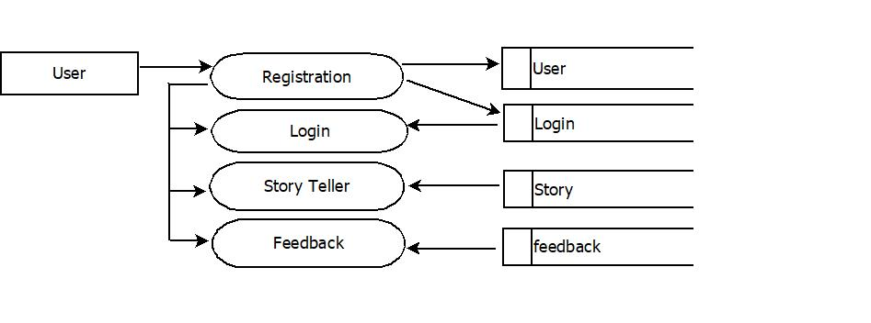
LEVEL 1.2

Slide 10
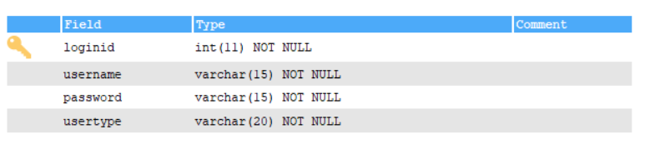
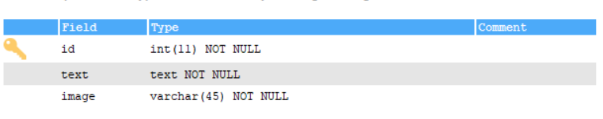
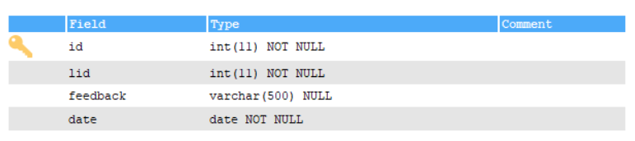
TABLE DESIGN
login
dataset
feedback

Slide 11
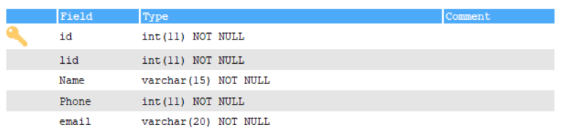
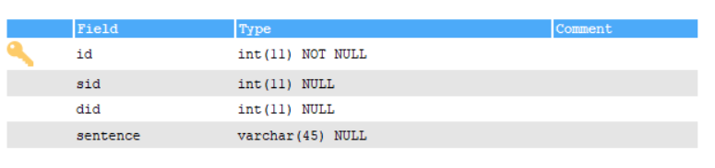
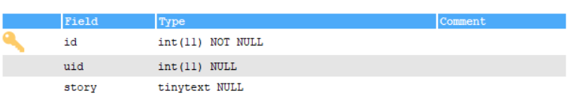
user
Image_story
story

Slide 12
DEVELOPING ENVIRONMENT
Processor : Intel Pentium IV
Monitor : Min. 14
RAM : 256 MB
Hard Disk : 80 GB
Keyboard : Standard 104 Keys
Modem : 56 Kbps
Mouse : Serial mouse
Operating System : Windows 8 or higher
Front End Tool : HTML, CSS, python
Back End Tool : MY SQL
IDE : Pycharm community, Android studio/eclipse
Web Browser : All new browsers

Slide 13
PRODUCT BACKLOG
User Story ID | Priority <High/Medium/Low> | Size (Hours) | Sprint <#> | Status <Planned/In progress/Completed> | Release Date | Release Goal
1 | Medium | 2 | 1 | Completed |  | Table design
2 | High | 3 |  | Completed |  | Form design
3 | High | 5 |  | Completed |  | Basic coding
4 | High | 5 | 2 | Planned |  | Manage dataset
5 | Medium | 5 |  | Planned |  | Text pre-processing
6 | High | 5 | 3 | Planned |  | Text similarity matching
7 | Medium | 5 |  | Planned |  | Image retrieval
8 | Medium | 5 | 4 | Planned |  | Testing data
9 | High | 5 |  | Planned |  | Output generation

Slide 14
USER STORIES
UserStoryID | As a <type of user> | I want to | So that I can
1 | Table design | Design tables for project | Create tables with normalization
2 | Form design | Complete form design | Complete form designs for our project
3 | Linking | Load and link html pages | Complete load and link
4 | Admin | Login | Login successful with correct username and password
5 | Admin | View users | View registered users
6 | Admin | View feedback | View feedbacks send by users
7
8

Slide 15
PROJECT PLAN
User story ID | Task name | Start date | End date | Days | Status
Sprint1
1 | UI designing | 30/11/2021 | 02/12/2021 | 3 | Completed
2 | Database connectivity | 10/12/2021 | 12/12/2021 | 2 | Completed
3 | Coding | 22/11/2021 | 31/12/2021 | 5 | Completed
Sprint2
4 | UI designing | 15/01/2022 | 17/01/2022 | 2 | In progress
5 | Database connectivity | 21/01/2022 | 22/01/2022 | 1 | In progress
6 | Coding | 25/01/2022 | 31/01/2022 | 6 | In progress

Slide 16
User story ID | Task name | Start date | End date | Days | Status
Sprint3
7 | UI designing | 05/02/2022 | 07/02/2022 | 2 | In progress
8 | Database connectivity | 09/02/2022 | 10/02/2022 | 1 | In progress
9 | Coding | 12/02/2022 | 21/02/2022 | 9 | In progress
10 | Testing & validation | 23/02/2022 | 24/02/2022 | 1 | In progress
Sprint4
11 | UI designing | 25/02/2022 | 27/02/2022 | 2 | In progress
12 | Database connectivity | 28/02/2022 | 01/03/2022 | 1 | In progress
13 | Coding | 02/03/2022 | 07/03/2022 | 5 | In progress

Slide 17
SPRINT BACKLOG PLAN
Backlog Item | Status & completion date | Original estimate in hours | Day1 | Day2 | Day3 | Day4 | Day5 | Day6 | Day7 | Day8 | Day9 | Day10 | Day11 | Day12 | Day13 | Day14
User story #1 |  | hrs | hrs | hrs | hrs | hrs | hrs | hrs | hrs | hrs | hrs | hrs | hrs | hrs | hrs | hrs
UI designing | 18/12/2021 | 3 | 1 | 1 | 1 | 0 | 0 | 0 | 0 | 0 | 0 | 0 | 0 | 0 | 0 | 0
Database connectivity | 24/12/2021 | 2 | 1 | 1 | 0 | 0 | 0 | 0 | 0 | 0 | 0 | 0 | 0 | 0 | 0 | 0
Coding | 08/01/2022 | 5 | 1 | 0 | 2 | 1 | 1 | 0 | 0 | 0 | 0 | 0 | 0 | 0 | 0 | 0
Testing
User story #2
UI designing
Database connectivity
Coding
Testing

Slide 18
SPRINT ACTUAL
Backlog Item | Status & completion date | Original estimate in hours | Day1 | Day2 | Day3 | Day4 | Day5 | Day6 | Day7 | Day8 | Day9 | Day10 | Day11 | Day12 | Day13 | Day14
User story #1 |  | hrs | hrs | hrs | hrs | hrs | hrs | hrs | hrs | hrs | hrs | hrs | hrs | hrs | hrs | hrs
UI designing | 18/12/2021 | 3 | 1 | 1 | 1 | 0 | 0 | 0 | 0 | 0 | 0 | 0 | 0 | 0 | 0 | 0
Database connectivity | 24/12/2021 | 2 | 1 | 1 | 0 | 0 | 0 | 0 | 0 | 0 | 0 | 0 | 0 | 0 | 0 | 0
Coding | 08/01/2022 | 5 | 1 | 0 | 2 | 1 | 1 | 0 | 0 | 0 | 0 | 0 | 0 | 0 | 0 | 0
Testing
User story #2
UI designing
Database connectivity
Coding
Testing

